Slide 1






Analyzing Factors Influencing Earnings
Salary Prediction for Data Professionals
By- Harshit Ghosh

Slide 2

INTRODUCTION
Importance of Salary Prediction :
In today's data-driven world, understanding salary trends is crucial for data professionals to make informed career decisions.
Predicting salaries helps with upskilling, job changes, and salary negotiations.
Data Professional Demand:
The demand for skilled data professionals is rapidly increasing.
Salary prediction empowers individuals to navigate their career paths and maximize earning potential.

Slide 3

PROJECT MISSION
01
02
03
04
05
06
EXPLORATORY DATA ANALYSIS
FEATURE ENGINEERING
DATA PREPROCESSING
MACHINE LEARNING MODEL
MODEL EVALUATION
ML PIPELINES
UNCOVER PATTERNS & RELATIONSHIPS
CREATE NEW INSIGHTS FROM DATA
PREPARE DATA FOR MODELING
FIND THE BEST-PERFORMING MODEL
ASSESS ACCURACY USING METRICS
GENERATE PREDICTIONS FOR NEW DATA

Slide 4




EXPLORATORY DATA ANALYSIS (EDA):
Understand data distribution and identify outliers.
Visualize relationships between variables like experience and salary.
Summarize key statistics (mean, median, standard deviation).
01

Slide 5

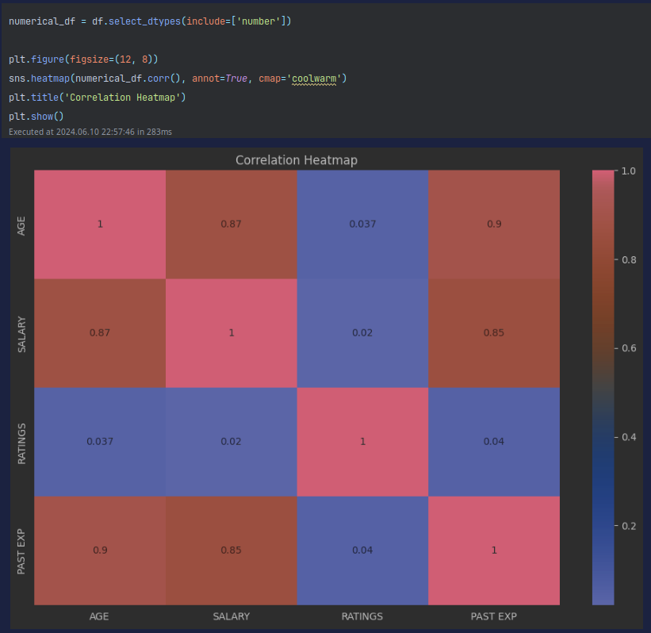


Slide 6
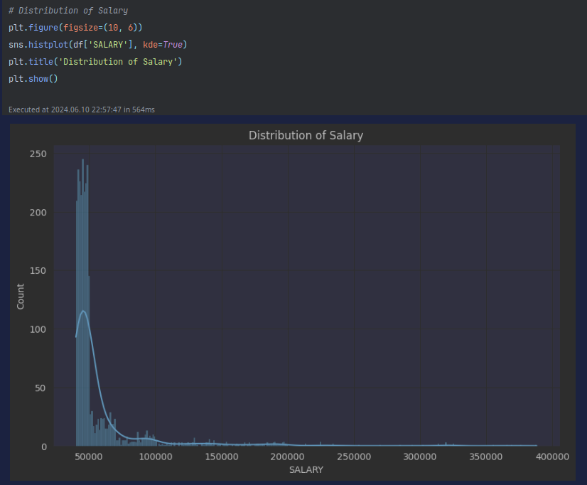
SALARY DISTRIBUTION

Slide 7
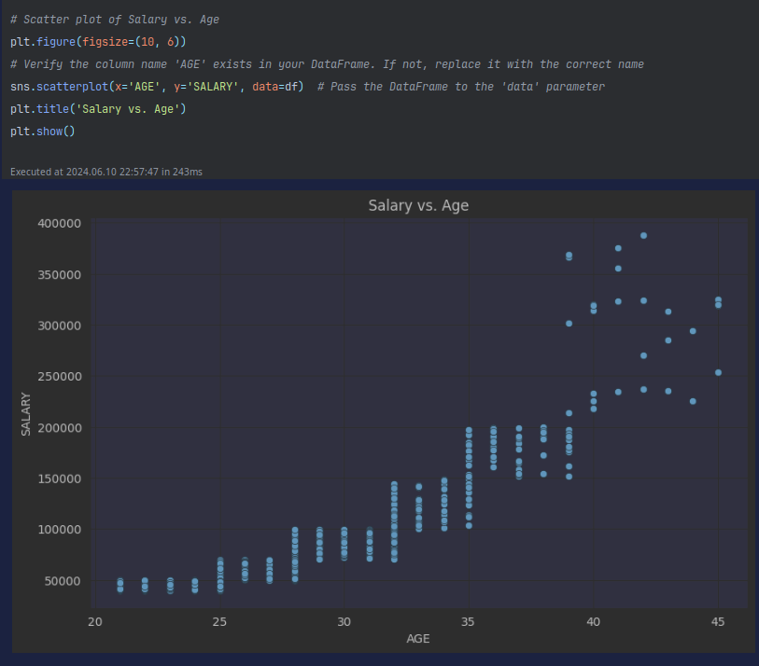
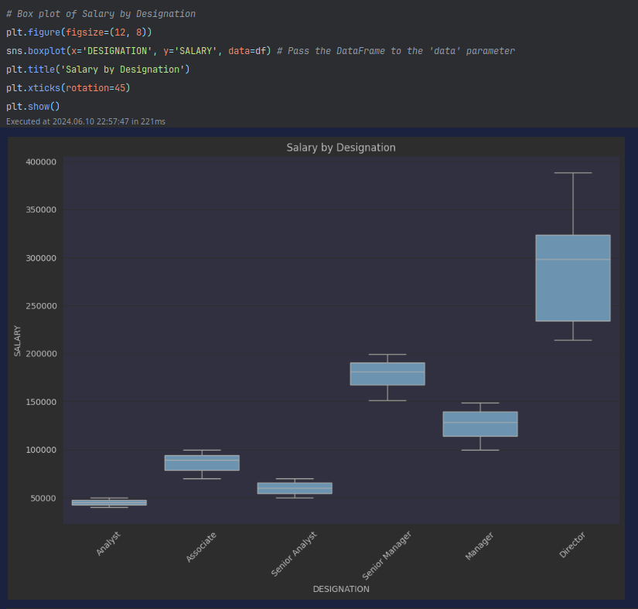
SALARY VS AGE
SALARY AS PER DESIGNATION

Slide 8
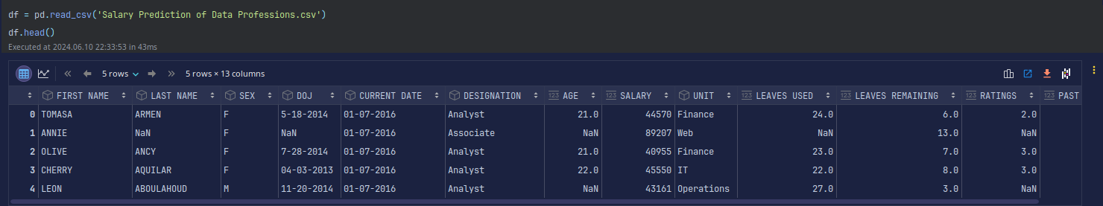
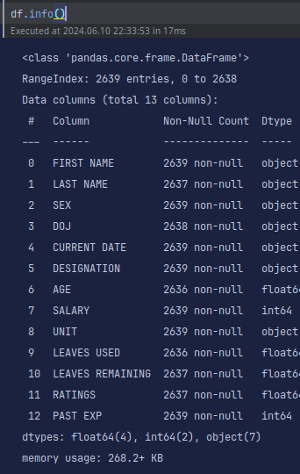
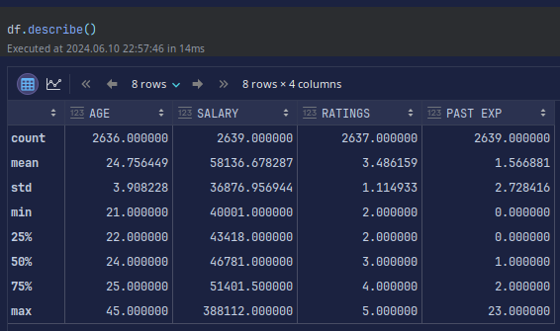

Slide 9
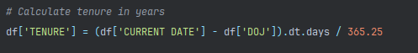
FEATURE ENGINEERING
Create new features from existing ones (e.g., experience squared).
Encode categorical variables (e.g., job title to one-hot encoding).
Transform features to improve model performance (e.g., scaling).
01
LONGER TENURE GENERALLY CORRELATES WITH HIGHER SALARY, INDICATING THATexperience within the company is rewarded.

Slide 10
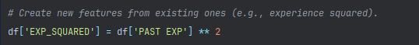
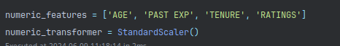
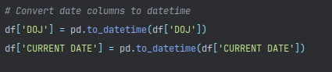
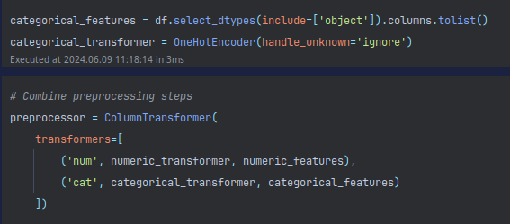
SQUARING EXPERIENCE (EXP^2) IN EDA HELPS CAPTURE POTENTIAL NON-LINEAR TRENDS IN SALARY GROWTH WITH EXPERIENCE, POTENTIALLY IMPROVING MODEL PREDICTIONS.
COLUMNTRANSFORMER STREAMLINES FEATURE ENGINEERING: COMBINES DIFFERENT PRE-PROCESSING METHODS FOR VARIOUS DATA TYPES (CATEGORICAL & NUMERICAL) INTO A SINGLE STEP.
UNLOCKS TAILORED TRANSFORMATIONS: ENSURES CATEGORICAL DATA GETS EFFICIENTLY ENCODED (E.G., ONEHOTENCODER) WHILE ALLOWING CUSTOM METHODS FOR NUMERICAL FEATURES.

Slide 11
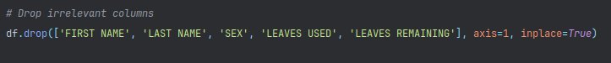
DATA PREPROCESSING
Prepare the data for model training by :
Drop irrelevant columns
Handle missing values
Encode categorical variables
Scale numerical features
01

Slide 12
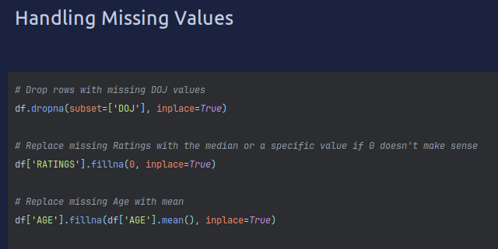

Slide 13
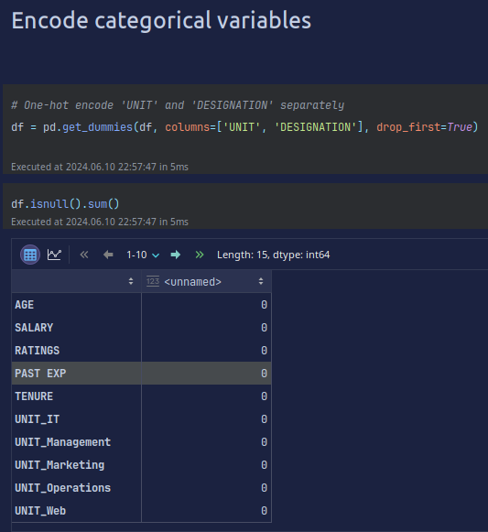
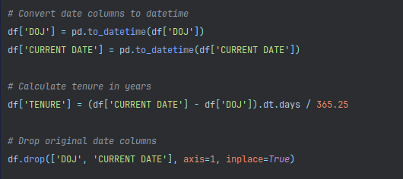

Slide 14
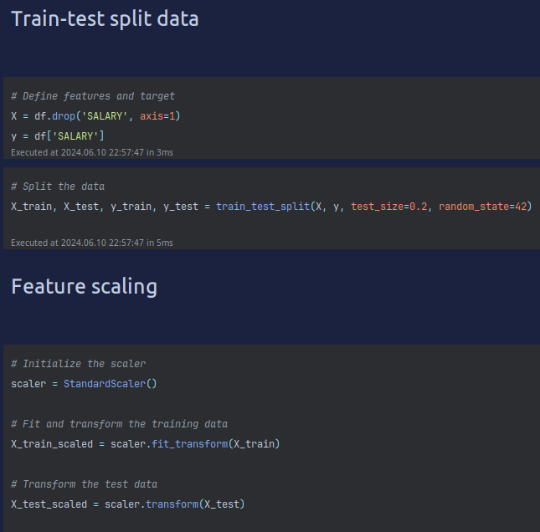

Slide 15
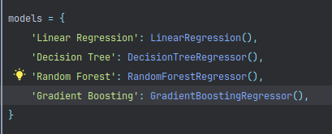
MACHINE LEARNING MODEL DEVELOPMENT
Train various regression models
Evaluate model performance using metrics like MAE, MSE, RMSE, and R-squared.
Visualization of predicted vs actual salaries
01

Slide 16
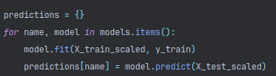
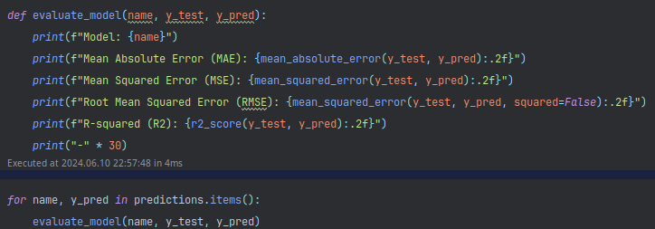
EVALUATING THE PERFORMANCE OF EACH SELECTED MODEL

Slide 17
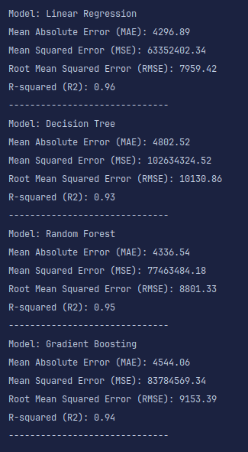
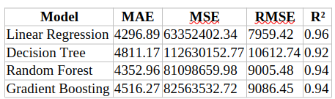
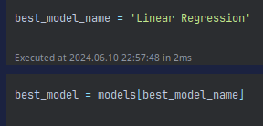
FROM THE RESULT WE CHOOSE LINEAR REGRESSION

Slide 18
Which Model to Choose
LINEAR REGRESSION: THIS MODEL HAS THE HIGHEST R-SQUARED VALUE (0.96), WHICH INDICATES IT EXPLAINS 96% OF THE VARIANCE IN SALARY. IT ALSO HAS THE LOWEST MEAN ABSOLUTE ERROR (MAE) OF 63,352,402.34, WHICH MEANS THE AVERAGE DIFFERENCE BETWEEN THE PREDICTED SALARY AND THE ACTUAL SALARY IS MINIMIZED.
DECISION TREE: THIS MODEL HAS A LOWER R-SQUARED VALUE (0.92) COMPARED TO LINEAR REGRESSION, INDICATING IT EXPLAINS LESS OF THE VARIANCE IN SALARY. IT ALSO HAS A HIGHER MAE (48,111.70), SIGNIFYING A HIGHER AVERAGE DIFFERENCE BETWEEN PREDICTED AND ACTUAL SALARIES.
RANDOM FOREST AND GRADIENT BOOSTING: THESE MODELS HAVE SLIGHTLY LOWER R-SQUARED VALUES (0.94) THAN LINEAR REGRESSION BUT HIGHER MAE VALUES (AROUND 43,500 AND 45,100).

Slide 19
Why Choose This Model
INTERPRETABILITY: LINEAR REGRESSION IS A SIMPLER MODEL AND EASIER TO INTERPRET. YOU CAN UNDERSTAND HOW EACH FEATURE CONTRIBUTES TO THE PREDICTED SALARY. THIS CAN BE VALUABLE FOR UNDERSTANDING THE FACTORS THAT INFLUENCE SALARY THE MOST.
ACCURACY: WHILE THE DIFFERENCE IN MAE BETWEEN LINEAR REGRESSION AND OTHER MODELS MIGHT SEEM SIGNIFICANT, IT'S IMPORTANT TO CONSIDER THE SCALE OF THE SALARIES BEING PREDICTED. IN REAL-WORLD SCENARIOS, THESE DIFFERENCES MIGHT BE NEGLIGIBLE.
Why Linear Regression might be preferred here:

Slide 20
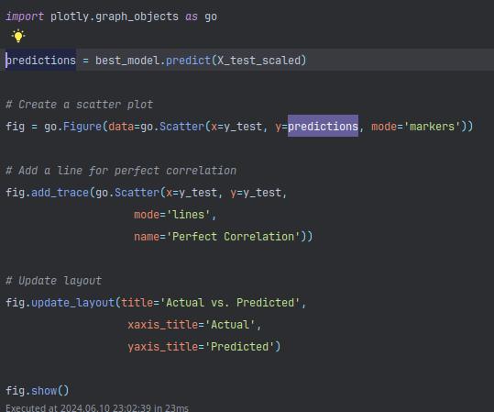
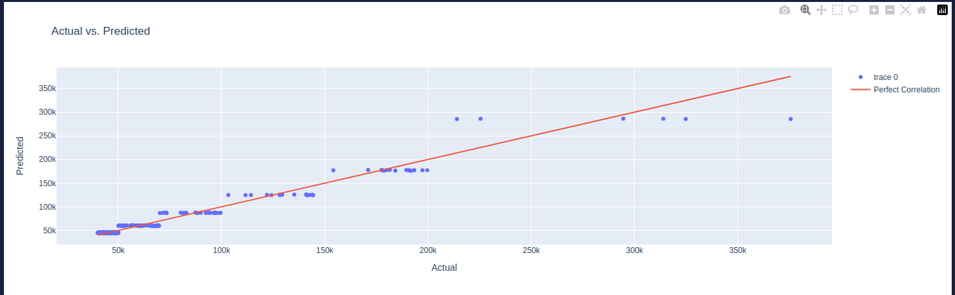
A graph of Actual Value V/S Predicted Value

Slide 21
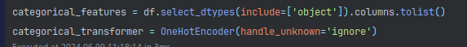
ML PIPELINES AND MODEL DEPLOYMENT
Create ML pipelines for efficient model training and deployment.
Deploy the best model to generate predictions
01

Slide 22
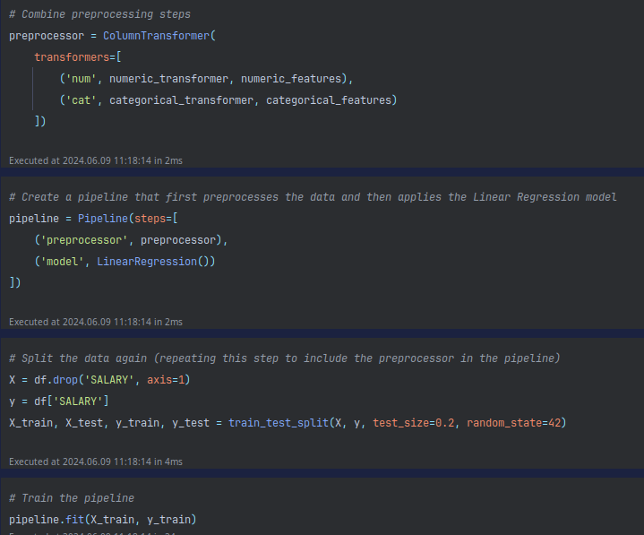
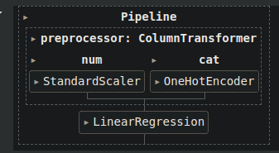

Slide 23
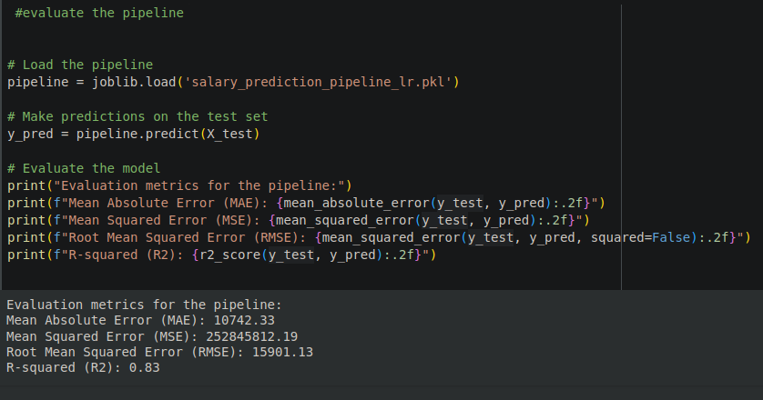

Slide 24
RECOMMENDATIONS FOR DATA PROFESSIONALS
Focus on Experience:
Gaining experience is crucial, as evidenced by the positive coefficient for 'PAST EXP'.
Develop In-Demand Skills:
Analyze coefficients of features related to specific skills (e.g., 'DESIGNATION' dummies) to identify high-paying skillsets.
Consider online courses, bootcamps, certifications, or personal projects to acquire these skills.
01

Slide 25
RECOMMENDATIONS FOR DATA PROFESSIONALS
Continuous Learning:
While formal education ('RATINGS') might have a weaker impact, continuous learning is valuable through workshops, conferences, etc.
Tenure Considerations:
A positive coefficient for 'TENURE' suggests potential benefits of staying with a company for long-term growth.
However, be aware of the possibility of career stagnation. Evaluate opportunities for advancement within the company.
02

Slide 26

THANK YOU!

